Slide 1



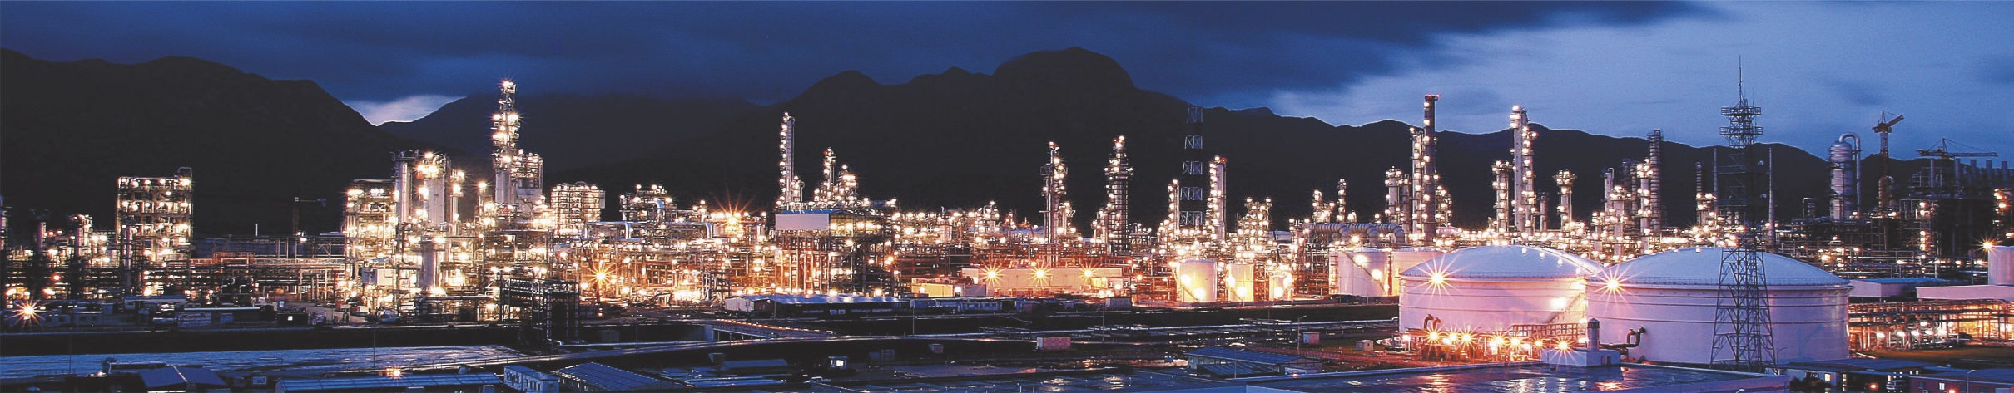

East China Engineering Science and Technology Co., Ltd.
Brief Introduction
2 0 1 9

Slide 2
1
A GLANCE AT ECEC
2
BUSINESS & SERVICES
CONTENTS
3
TYPICAL PROJECTS
4
REFERENCES

Slide 3

A GLANCE AT ECEC
01
延迟付

Slide 4
Where We Are
Headquarters, Hefei
Shanghai Branch
Guizhou Branch

Slide 5
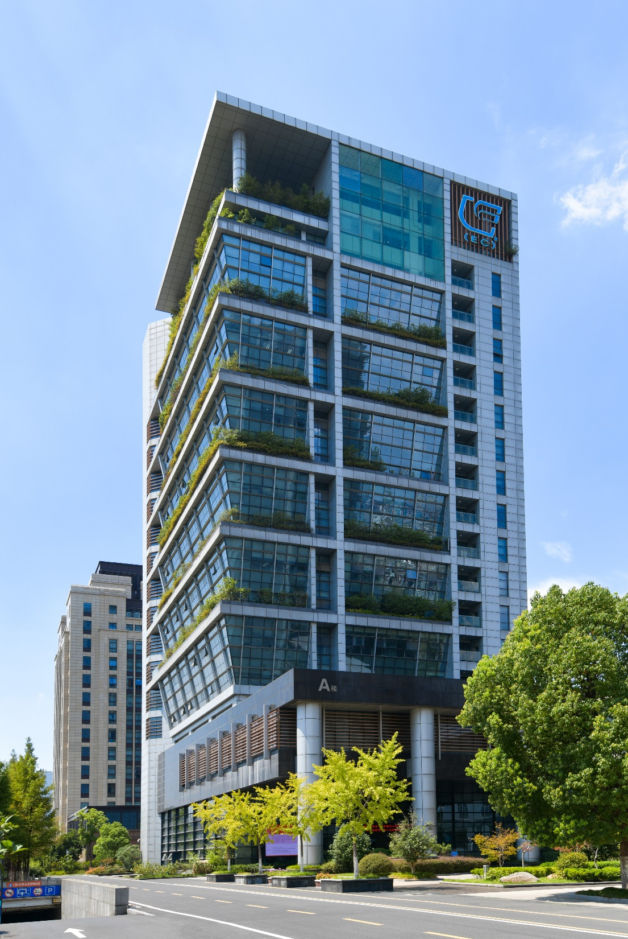

Who We Are
East China Engineering Science and Technology Co., Ltd. (or ECEC), located in Hefei, capital of Anhui Province, is a leading engineering, procurement and construction services provider in China.
ECEC is former the Third Design Institute of the Ministry of Chemical Industry, which was founded in 1963, and became a listed company in 2007.
ECEC is a member of China National Chemical Engineering Group Corporation (or CNCEC) , which is one of the top 100 state owned companies directly supervised by the State Council.

Slide 6
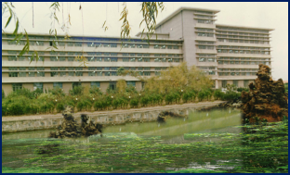
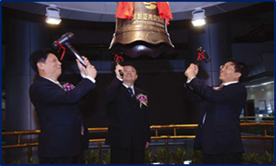
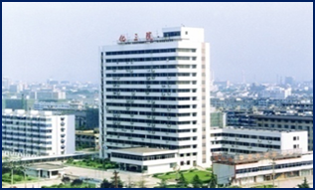
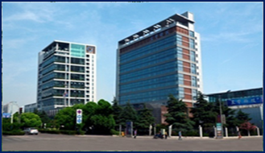
Growth History
1 Founded in Huainan
Founded in 1963 and named as The Third Design Institute of the Ministry of Chemical Industry.
3 IPO
On July 12, 2007, ECEC was listed in Shenzhen Stock Exchange with the code of stock 002140.
1963
1987
2007
2016
2 Moved to Hefei
Moved to Hefei, and business scope expanded from the sole consulting and engineering to EPC.
4 New Vision
Coal & NG based Chemicals, Environmental Governance & New Energy and Projects Overseas

Slide 7
Administration Office
Organization Chart
Human Resources Division
Financial & Assets Division
Shanghai Branch
Architecture Design Institute
Investing & law Division
Guizhou Branch
Auditing & Assessment Division
Board of Supervisors
Document Control Division
Process
R & D Center
Environment & Municipal Engineering Co., Ltd.
General Meeting
of Shareholders
Board of Directors
President
Business Development Division
Piping
Civil Structure & Architecture
Safety Management Committee
Risk-management Committees
Water Supply & Drainage
Procurement Division
Project Management Division
Construction Management Division
Equipment & Machinery
QA & QC Division
HSE Division
Electrical & Instrument
PMC Center
Cost Estimation

Slide 8
Overseas Offices
Casablanca, Morocco
Moscow, Russia
Jakarta, Indonesia
La Paz, Bolivia
Dubai, U.A.E
Cairo, Egypt

Slide 9
Manpower
1400 Employees

Slide 10
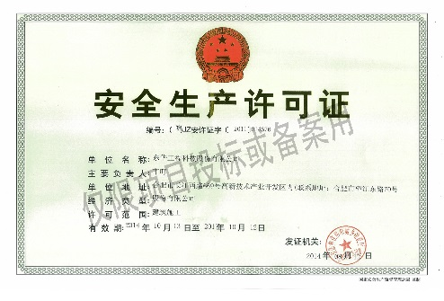
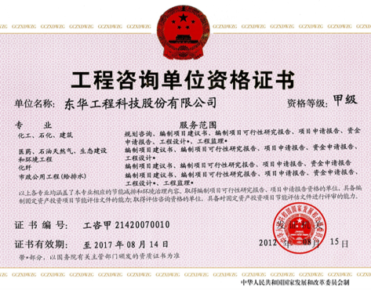
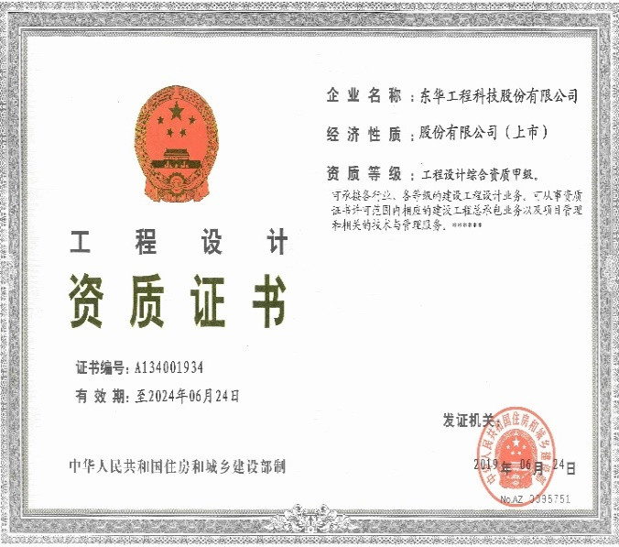
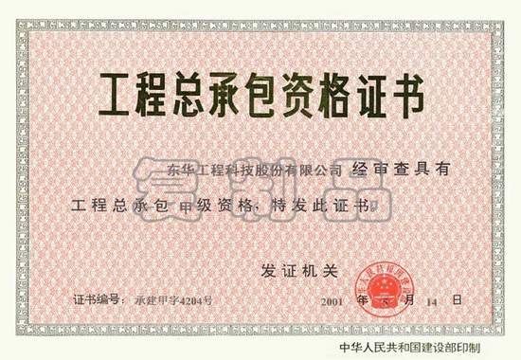
Top Certification
ECEC has top certification for EPC services in all 21 industrial sectors in China
Class A Comprehensive Certificate for Engineering Design
Class A Credential for Engineering Consultation
Class A Credential for Construction Supervision
Permit of Safety in Production

Slide 11
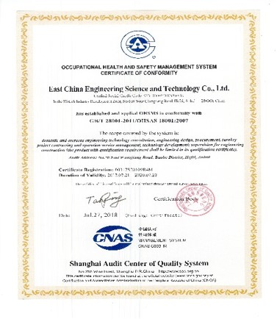
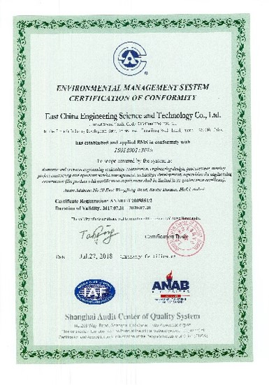
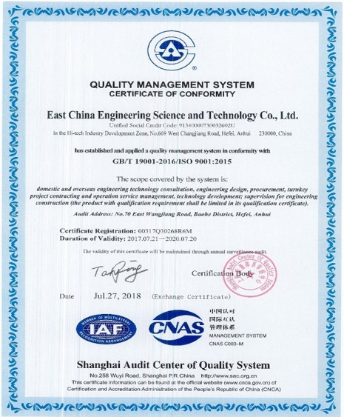


QHSE
ISO 9001 （CNAS, RVA, ANAB）
ISO 14001 （CNAS, ANAB）
OHSAS18001 （CNAS）
Three in One System
Management Manual
25 Management Procedures
1300+ Workbooks

Slide 12
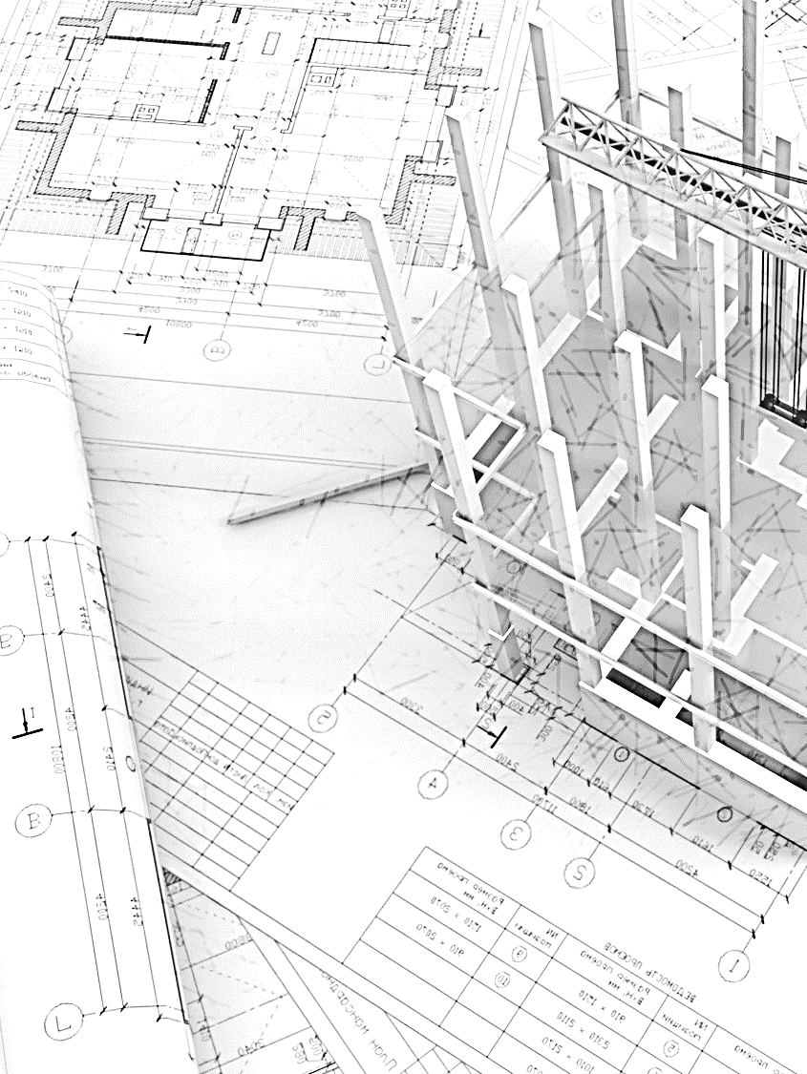
Research & Development
Designated Postdoctoral Research Station at state level
2018
Designated R&D Center by the State
2016
2013
Qualified as a firm with Integration of Informatization & Industrialization Management System by MIIT
Established R&D Center and became the first one of CNCEC
2002
Designated R&D Center by the Province
2000

Slide 13

Achievement & Awards
ECEC has completed more than 1600 large & mid sized projects, covering various fields and industries.
1600+
ECEC has won 338 state, provincial and ministerial awards, including State Science and Technology Award, Excellent Design Award and Quality Award.
338
ECEC holds 92 patents, including 38 inventions.
92

Slide 14


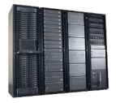



IP Protection
Access Control
Independent Server
PC without Disk
NDA by
Employees
IP Regulation
Taskforce
Office
USB Control
Doc Access with Authorization
Copy/Printing Record
Email Monitoring
Internet
Virtual Wall Server
VPN firewall
VPN firewall
Servers Group
Printer
Desktop Computer
Notebook Computer
Printer
Desktop Computer
Notebook Computer

Slide 15
02
BUSINESS & SERVICE
延迟付

Slide 16
Services Area
Opportunity Study, FSR & Conceptual Design
Engineering
Procurement
One Stop Solution
To A Project
Construction Management
Commissioning & Start up
EPC
PMC
Financing & Operation (BOT, TOT, BT)

Slide 17
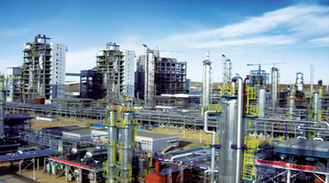
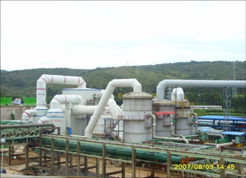
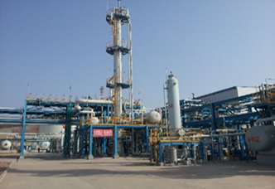
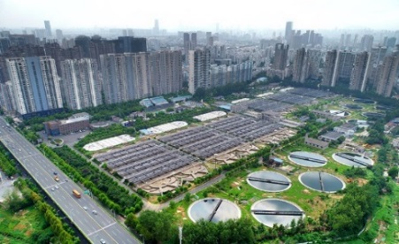
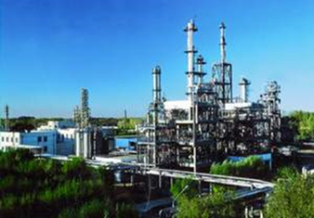
Core Business
Coal Chemicals
Basic Chemicals
Energy
Environmental
works
Others
Gasification
Ammonia/Urea
MTO/ DMM
MEG
Methane
FMTP
Sulfuric Acid
Phosphoric Acid
Caustic Soda
DAP / MAP
NP/NPK/TSP/SSP
Potassium
Hydrogen Generation
Nature Gas
LNG
Methanol
Ethanol
DME
PV/CSP
WWT
Waste & Hazardous
Solid Treatment
Gas Desulphurization
Petrochemical
MEK/MTBE/Melamine
TiO2 Pigment
Pharmaceuticals
Cryogenic Storage
Tank
Thermal Power Plant
Municipal Works
35%
20%
15%
9%
21%
Notes:
Coal Chemical 50%, Energy 15%, Basic Chemical 10%, Environmental Works 15%, others 10%

Slide 18






















Multinationals We Work with
Licensors & Engineering Companies

Slide 19









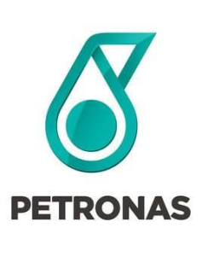













Multinationals We Work with
International Clients

Slide 20
Projects Overseas
Russia
Tunisia
Belarus
Japan
Ethiopia
Republic of Korea
Vietnam
Pakistan
Indonesia
Chile
Congo
Bangladesh
Australia

Slide 21
03
TYPICAL PROJECTS
延迟付

Slide 22
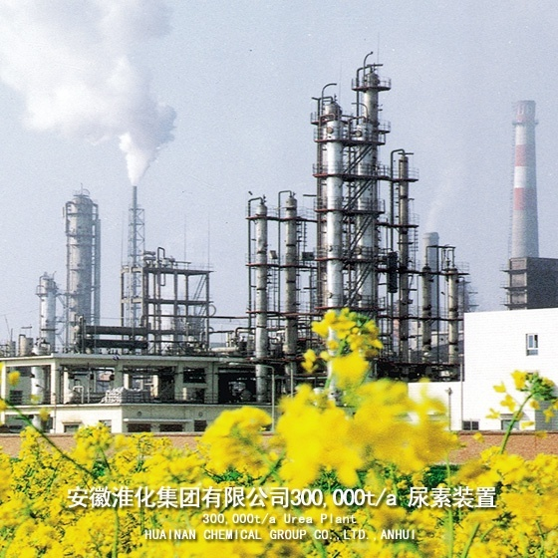
Coal-based Chemicals
Project:
180 kt/a Ammonia
300 kt/a Urea
Client:
Huainan Chemical
Location:
Huainan, China
Scope:
E

Slide 23
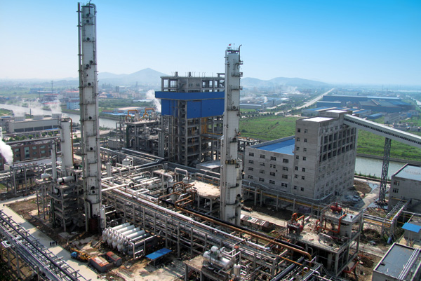
Coal-based Chemicals
Project:
450 kt/a Ammonia
800 kt/a Urea
Client:
Lingu Chemical
Location:
Yixing, China
Scope:
E

Slide 24
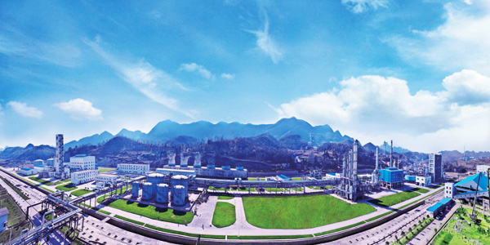
Coal-based Chemicals
Project:
300 kt/a Methanol
150 kt/a DME
Client:
Xinsheng Chemical
Location:
Liupanshui, China
Scope:
EPC

Slide 25
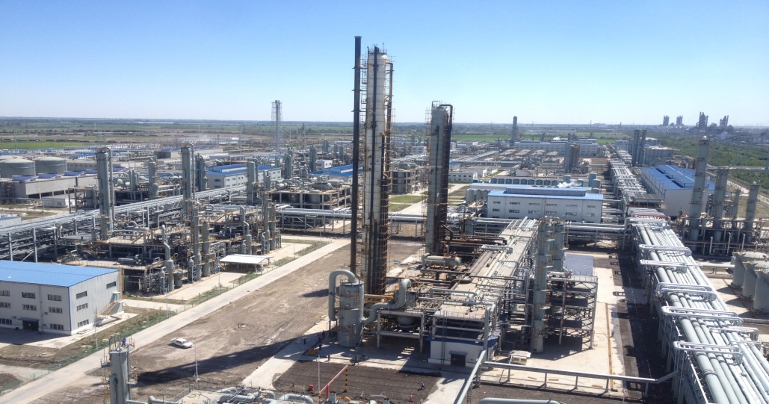
Coal-based Chemicals
Project:
200kt/a MEG
250kt/a Methanol
Client:
Xinjiang Tianye (Group)
Location:
Shihezi, China
Scope:
E

Slide 26
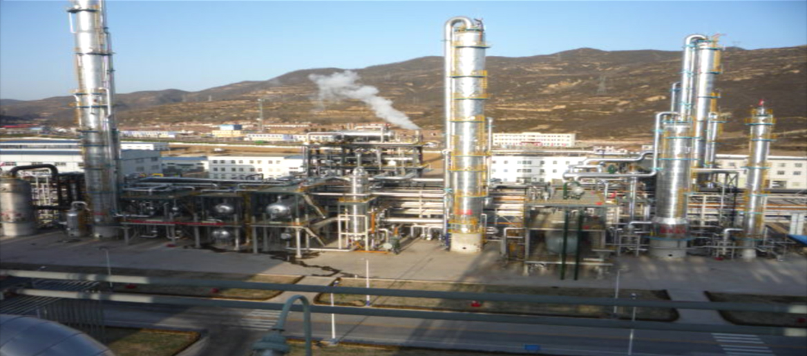
Coal-based Chemicals
Project:
600kt/a Methanol
Client:
Huating Zhongxu Location:
Pingliang, China
Scope:
EPC

Slide 27
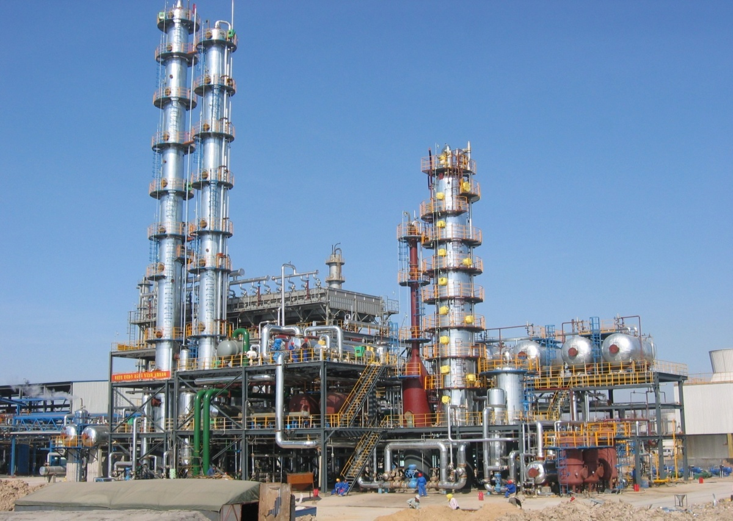
Coal-based Chemicals
Project:
100kt/a DME
Client:
Zhongjie Petrochemical Location:
Cangzhou , China
Scope:
EPC

Slide 28
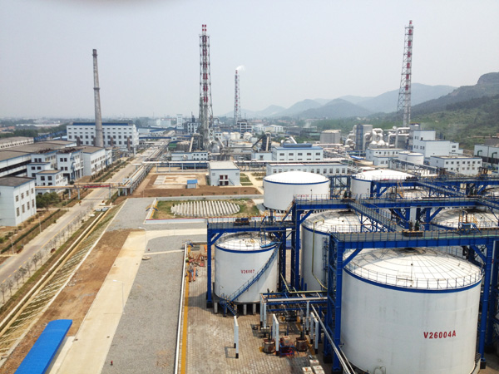
Fertilizer Complex
Project:
800 kt/a SA
600kt/a PA
Client:
Dayukou Phosphate Location:
Jingmen , China
Scope:
EPC

Slide 29
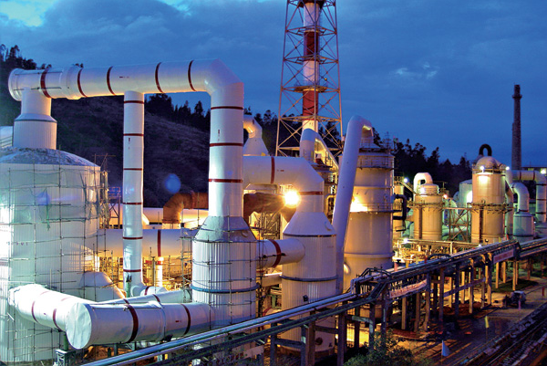
Fertilizer Complex
Project:
600 kt/a SA
Client:
Yunnan Three-Circle Location:
Kunming , China
Scope:
EPC

Slide 30
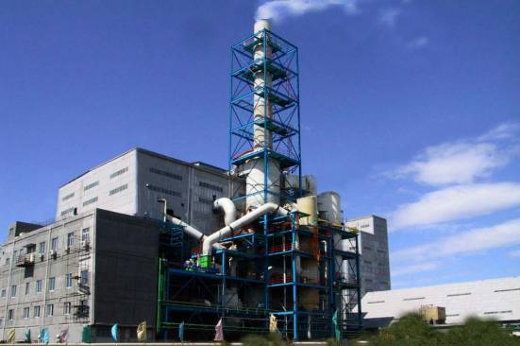
Fertilizer Complex
Project:
600 kt/a NPK
Client:
Sino-Arab Chemical Location:
Qinghuangdao , China
Scope:
EPC

Slide 31
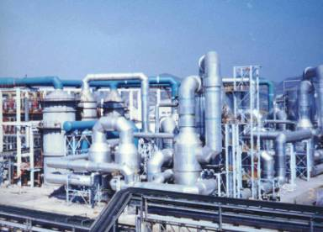
Fertilizer Complex
Project:
800 kt/a SA, Pyrite
Client:
Wengfu (Group) Location:
Guiyang , China
Scope:
EP+S

Slide 32
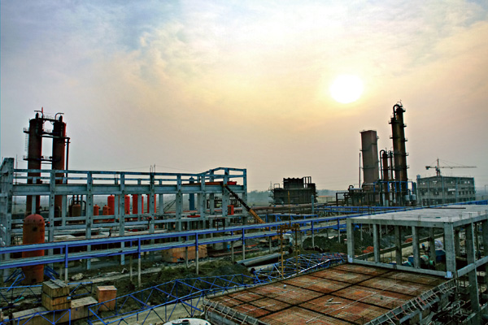
Oven Gas to Methanol
Project:
200 kt/a Methanol
Client:
Huaibei Linhuan Coking Location:
Huaibei , China
Scope:
EPC

Slide 33
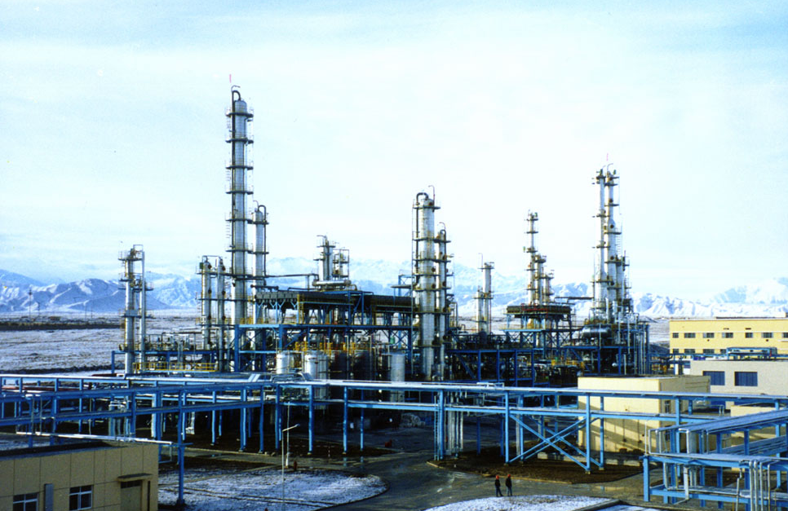
MEK Plant
Project:
30kt/a MEK
Client:
Xingjiang Tianli
Location:
Karamay, China
Scope:
EPC

Slide 34
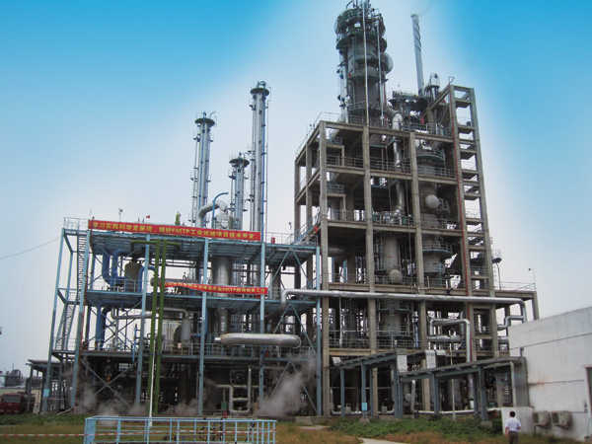
FMTA Project
Project:
10kt/a FMTA Industrial
    Pilot Plant
Client:
CNCEC
Location:
Huainan, China
Scope:
EPC+F

Slide 35
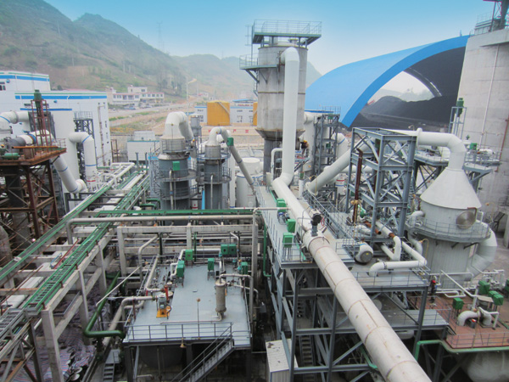
Gas Desulphurization
Project:
Effluent Gas
    Desulphurization
Client:
Guodian Duyun
Location:
Qiannan, China
Scope:
EPC

Slide 36
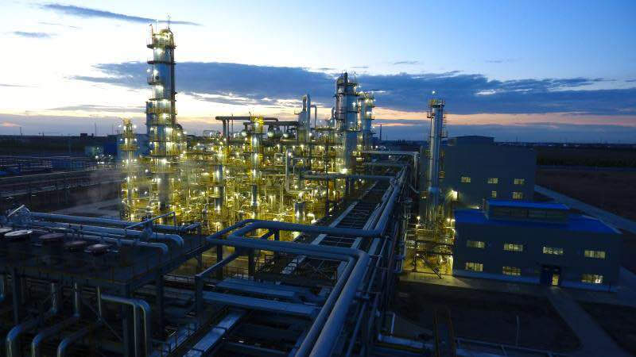
NG-based Chemicals
Project:
150 kt/a MEG
Client:
Tianchen Chemicals
Location:
    Shihezi, China
Scope:
EPC

Slide 37
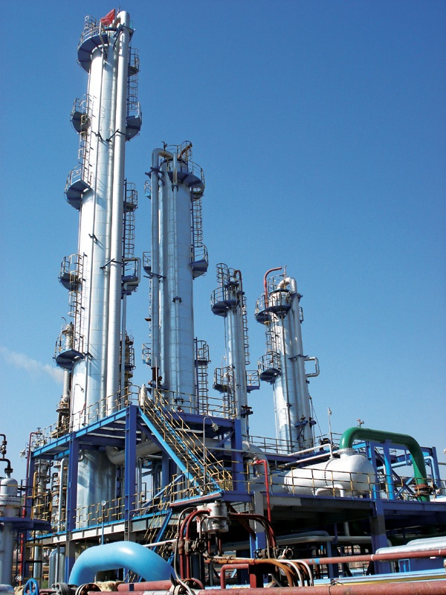
NG-based Chemicals
    Project: 200 kt/a Methanol
    Client: Lanzhou Lanxin Chemicals Co., Ltd.
    Location: Lanzhou, China
    Scope: EPC

Slide 38
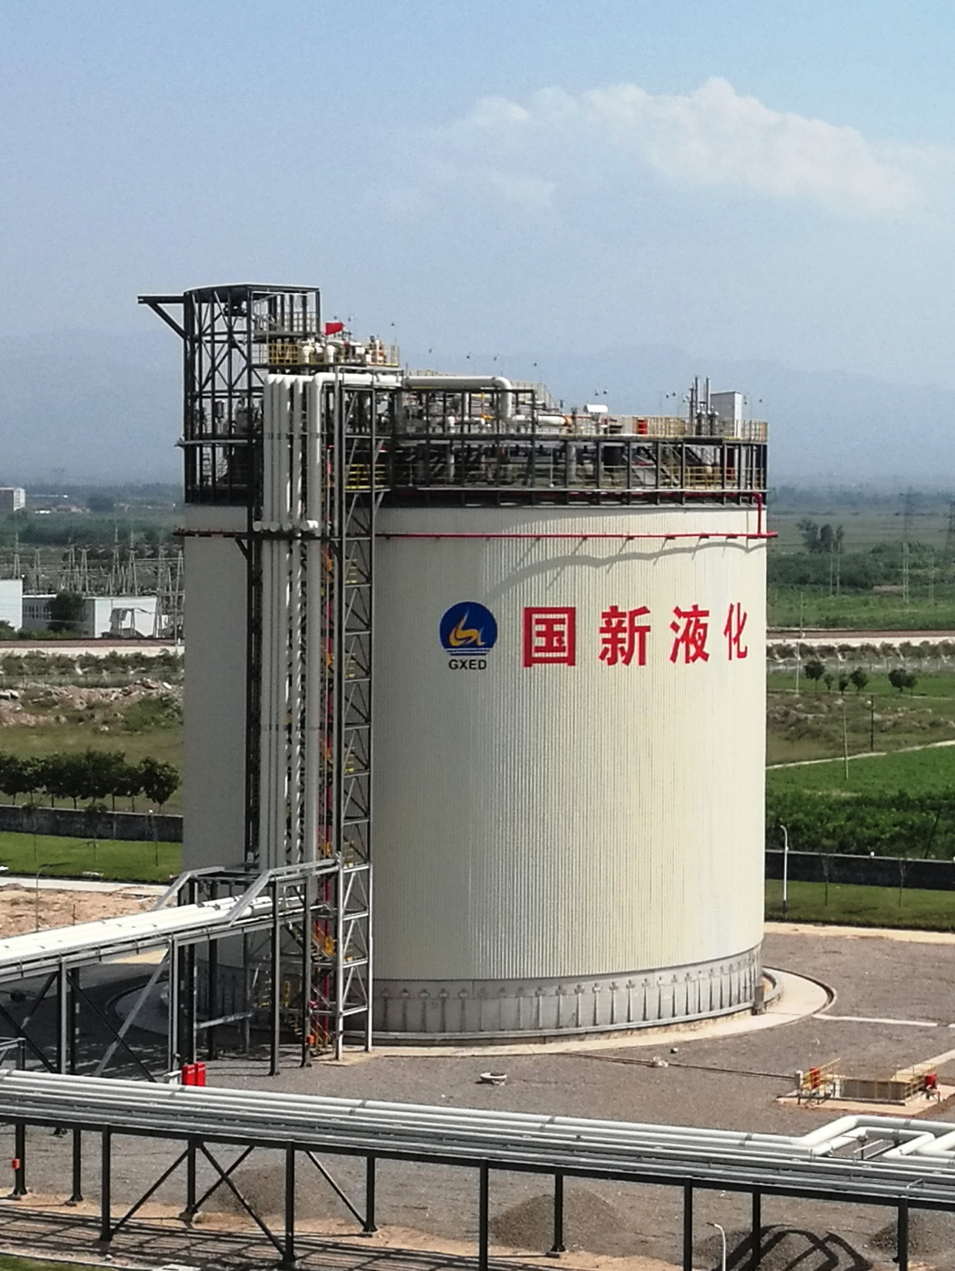
LNG Tank
Project: 20,000m3 LNG Tank
Client: Shanxi Natural Gas Co., Ltd
Location: Qixian
Scope: EPC

Slide 39
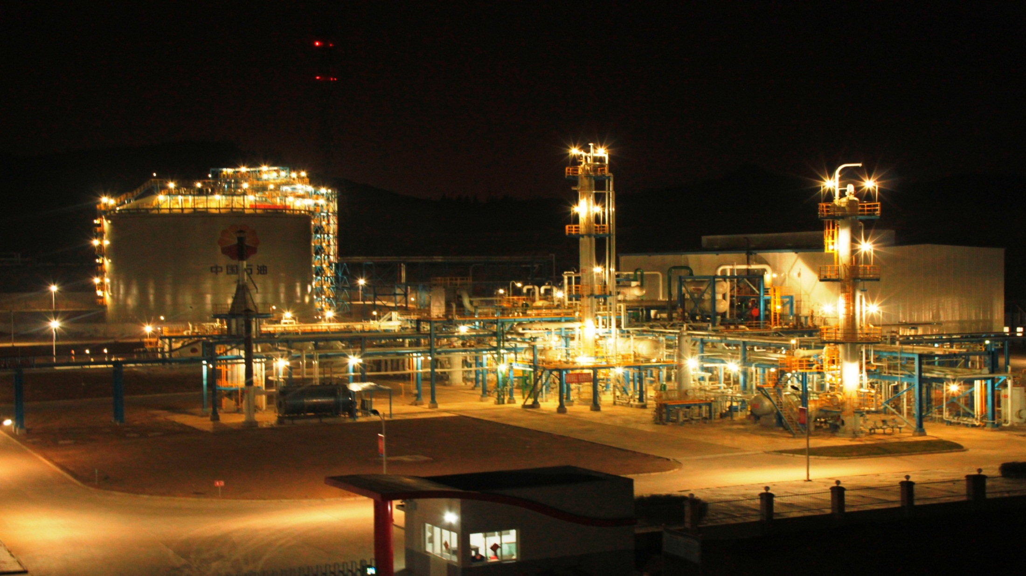
LNG Plant
Project:
1m Nm3/d LNG Plant
Client:
CNPC
Location:
Guangyuan, China
Scope:
EPC

Slide 40
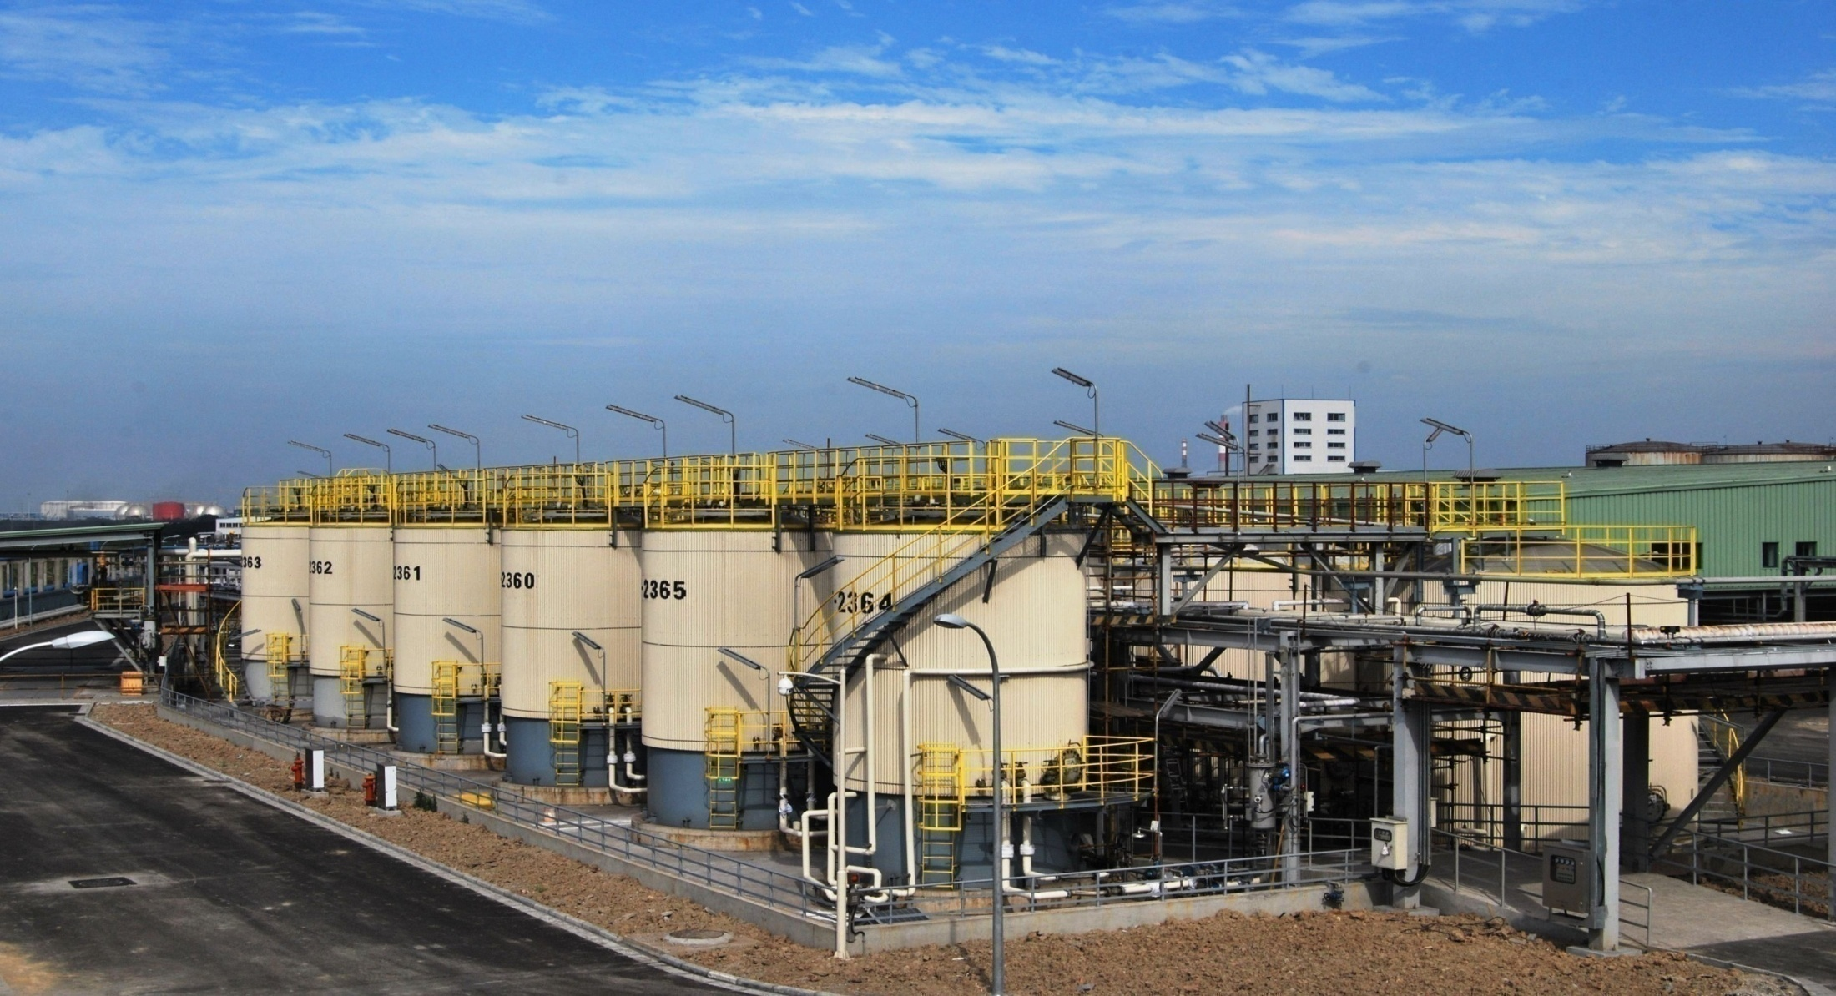
Lubricant Oil Blending Plant
Project:
225ML/a LOBP
Client:
Shell
Location:
Guangyuan, China
Scope:
EPC

Slide 41
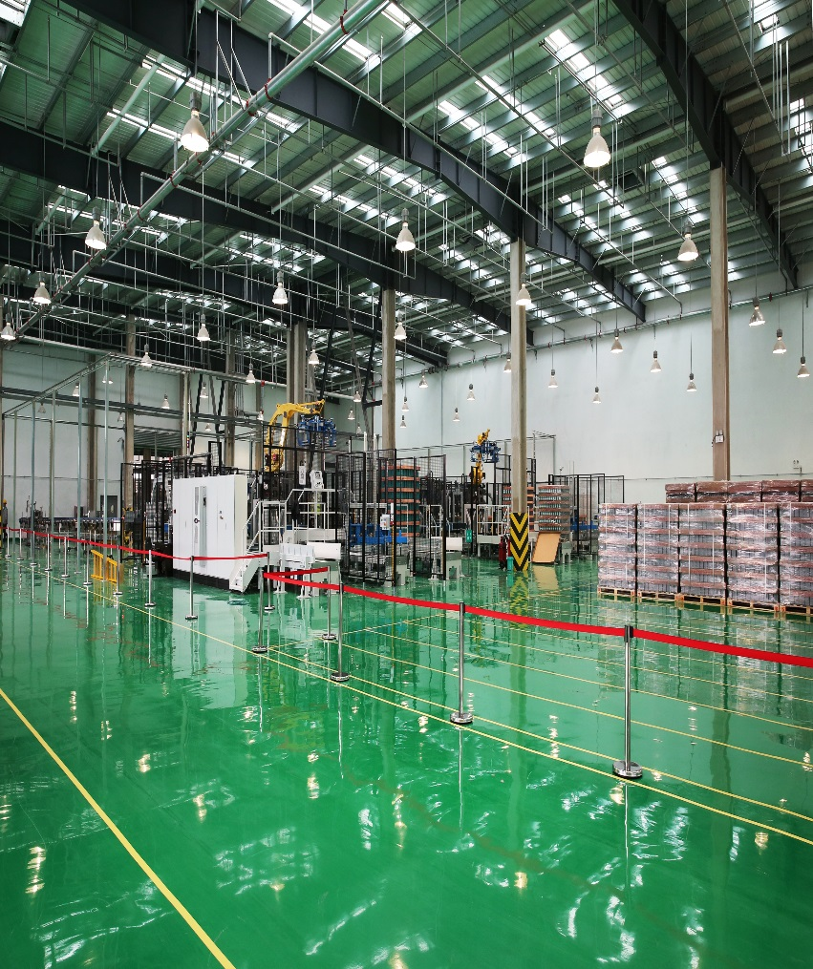
Lubricant Oil Blending Plant
Project:
150ML/a LOBP
Client:
Petranas
Location:
Weifang, China
Scope:
EPC

Slide 42
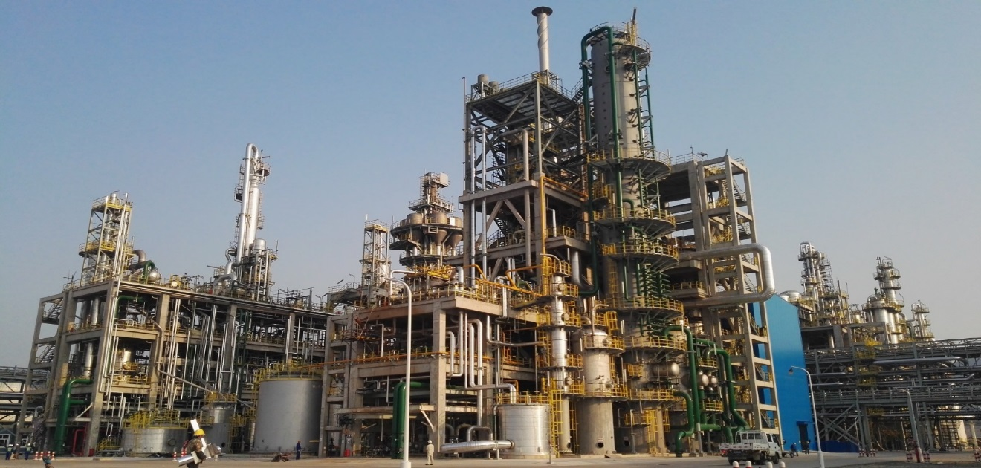
Fine Chemicals
Project:
200kt/a Caprolactam
Client:
DSM
Location:
Nanjing, China
Scope:
E+SS

Slide 43
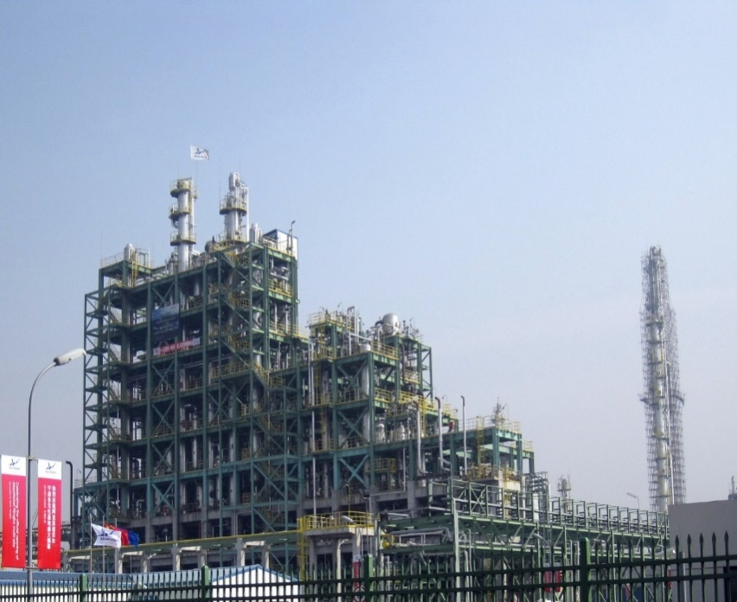
Fine Chemicals
Project:
35kt/a Ethylene Amine
Client:
Akzo Nobel
Location:
Ningbo, China
Scope:
EP

Slide 44
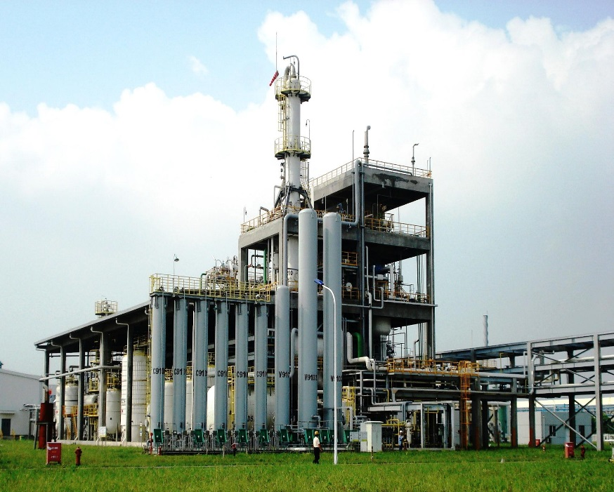
Fine Chemicals
Project:
35kt/a Specialty Amine
Client:
APCI
Location:
Nanjing, China
Scope:
E+PS

Slide 45
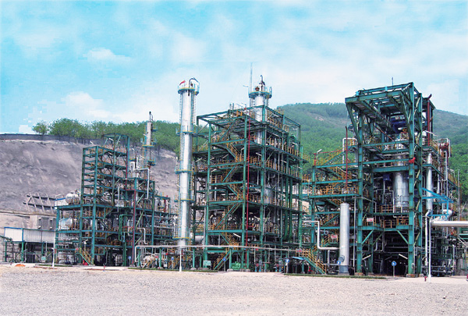
Melamine Plant
Project:
30kt/a Melamine Plant
Client:
CNNC Jiangfeng
Location:
Chongqing, China
Scope:
E

Slide 46
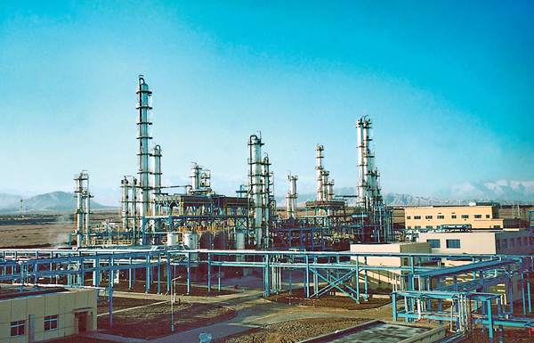
PVC Projects
Project:
1000kt/a PVC Plant
Client:
Anhui Hwasu Corporation
Location:
Chuzhou, China
Scope:
EPC

Slide 47
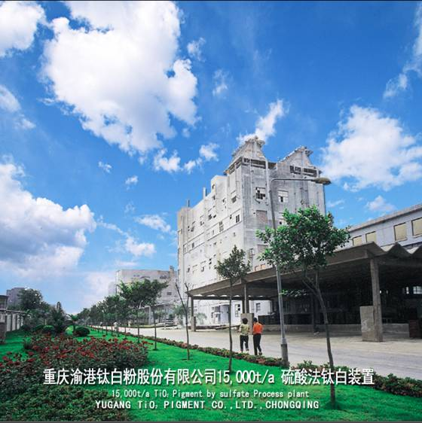
Paint & Coating
Project:
15kt/a TiO2 Pigment
Plant
Client:
Chongqing TiO2
Location:
Chongqing, China
Scope:
E

Slide 48
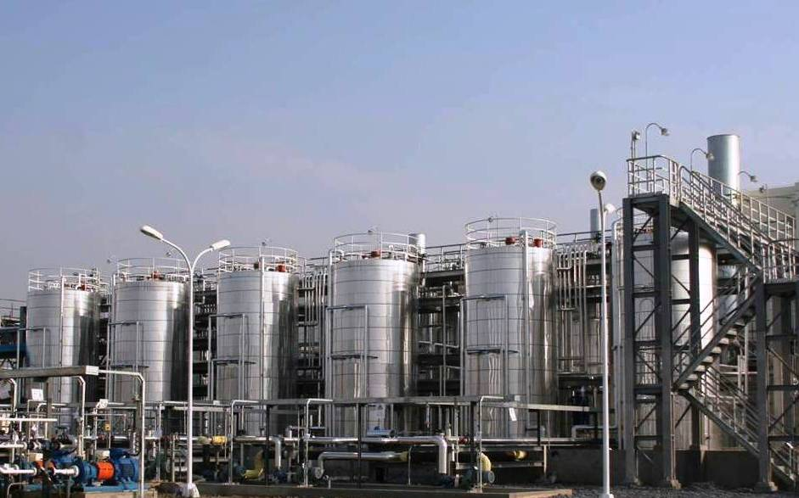
Paint & Coating
Project:
20kt/a Refinish Paint Plant,
Client:
DuPont
Location:
Shanghai, China
Scope:
DED+PS+SS

Slide 49
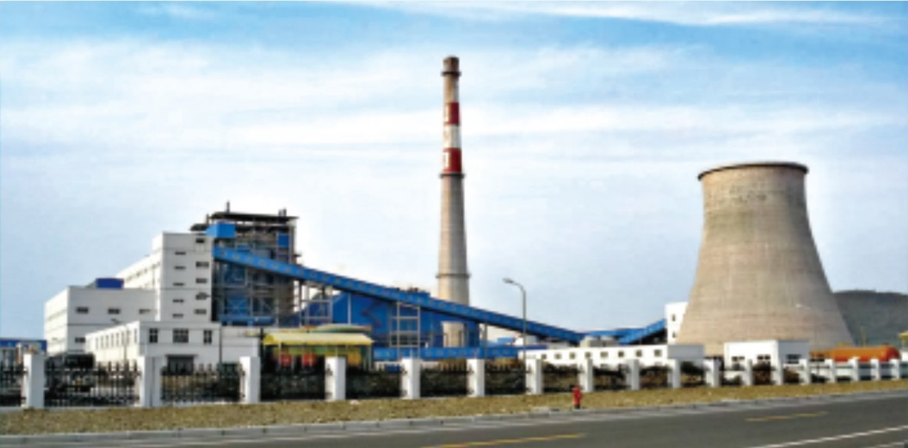
Thermal Power Plant
Project:
3X240t/h Boiler &
1X25MW Steam Turbine
Client:
Shenhua Ningxia Coal
Location:
Yinchuan, China
Scope:
E

Slide 50
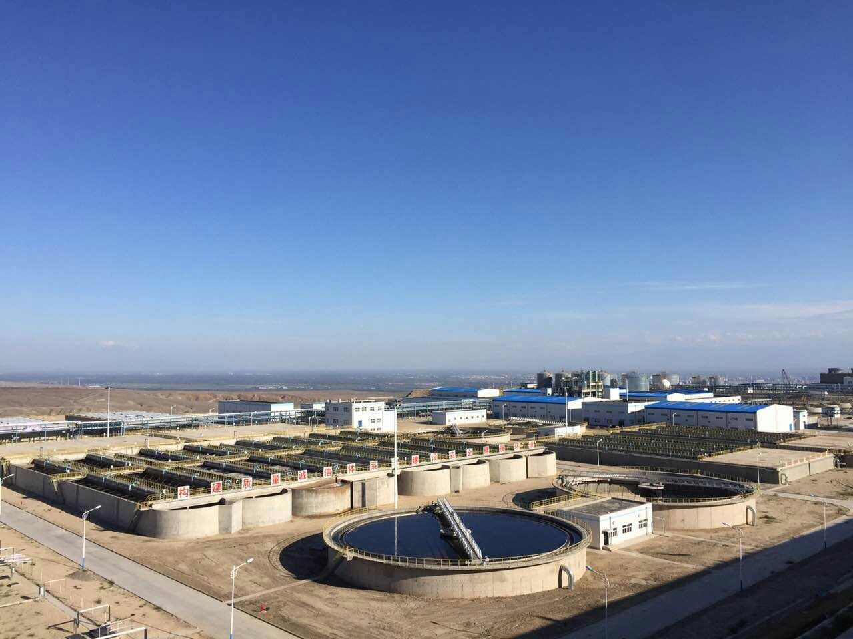
Waste Water Treatment
Project:
60,000 m3/d WWT for
Coal to Methane ,
Client:
Yili Xintian Coal Chemical
Location:
Yili, China
Scope:
EPC

Slide 51

Waste Water Treatment
Project:
300km3/d Municipal
WWTP ,
Client:
Wangxiaoying WWTP
Location:
Hefei, China
Scope:
TOT

Slide 52


Waste Water Treatment
Project:
30000 m3/d WWTP
Client:
Nanchong EDC
Location:
Nanchong, China
Scope:
BOT

Slide 53

Overseas Projects
Project:
240kt/a DAP,
Client:
B.C.I.C.,
Location:
Chittagong，Bangladesh
Scope:
EPC

Slide 54




Overseas Projects
Project:
330 kt/a DAP, 400 kt/a SA
170 kt/a PA, 12000KW Thermal Power Plant
Client:
VINACHEM,
Location:
Haiphong, Vietnam,
Scope:
EPC

Slide 55

Overseas Projects
Project:
1800 MTPD Sulfuric Acid Plant
Client:
GCT
Location:
Gafsa, Tunisia
Scope:
EPC

Slide 56

Overseas Projects
Project:
400 kt/a Trisodium Phosphate (TSP)
Client:
GCT
Location:
Gafsa,Tunisia
Scope:
EPC

Slide 57
THANKS FOR WATCHING
For more details, please refer to
Http://www.chinaecec.com
2019, Hefei

